Slide 1

EMPLOYEE DATA ANALYSIS USING EXCEL
NAME: HAZIMOONISHA.A
REGISTER NO : asunm1325312208195
DEPARTMENT : COMMERCE
COLLEGE : SIR THEAGARAYA COLLEGE

Slide 2

PROJECT TITLE
EMPLOYEE ANALYSIS ACCORDING TO EMPLOYEE ATTENDANCE

Slide 3
AGENDA
1.PROBLEM STATEMENT
2.PROJECT OVERVIEW
3.END USERS
4.OUR SOLUTION AND PROPOSITION
5.DATASET DESCRIPTION
6.MODELLING APPROACH
7.RESULTS AND DISCUSSION
8.CONCLUSION

Slide 4
PROBLEM STATEMENT
Employee management system is an application based system, having two applications developed, one for employers to manage employee details and another for employees to mark their attendance. Every organization whether government or private uses an information system to store data of their staff.
Keywords : attendance, employee management, payroll,
salary calculation.
*Total of per day rate of employee.
* Average total of hourly rate.

Slide 5
PROJECT OVERVIEW
Its subsections will turn the attention to the method for resolving the problem, the programming environments used for developing the system and the implementation of the operations performed upon the database
• TABELS
• CONDITIONAL FORMATING
• PIVOT CHART – LINE CHART , PIE CHART
• SUM FORMULAS
• SLICERS

Slide 6
WHO ARE THE END USERS?
HUMAN RESOURCES DEPARTMENT
SALES DEPARTMENT
RESEARCH AND DEVELOPMENT

Slide 7
OUR SOLUTION AND IT S VALUE PROPOSITION
➢ COMPREHENSIVE DATA MANAGEMENT :
• data organization
• Data integration
➢ SCENERIO ANALYSIS :
• used to analyse different situation
➢ ADVANCE ANALYTICAL TOOLS :
• formulas and functions
• Pivot tables
➢ USER- FRIENDLY INTERFACE :
• accessibility
• EASE OF USE
➢ Visual representation :
• charts and graphs

Slide 8
DATASET DESCRIPTION
➢ DATA OVERVIEW :
The use of data analysis on candidate and employee issues to understand their effects on business goals and evaluated the effectiveness of HR initiatives.
➢ DATA FIELD :
• Empid
• Age
• Department
• Educational field
• gender
• Hourly rate
• Marital status
• Per day rate

Slide 9
MODELLING
• DATA CLEANING.
• CREATING TABLE.
• .CREATING PIVOT CHART.
• .CREATING DASHBOARD.
• INSERTING PIVOT CHART IN DASHBOARD.
• INSERTING FORMULAS IN DASH BOARD TO MAKE
INTERACTION.
• CREATING INTERACTIVE DASHBOARD BY PUTTING ALL
TOGETHER ELEMENTS.

Slide 10
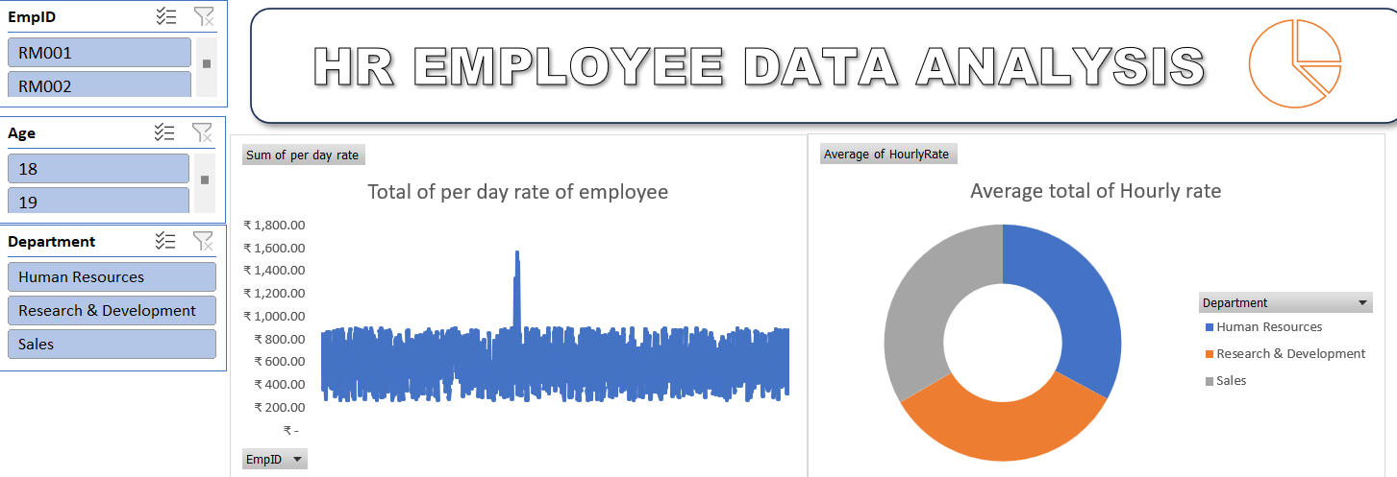
RESULTS
(click to open file)

Slide 11
CONCLUSION
Employee management system is an application based system,
having two applications developed, one for employers to
manage employee details and another for employees to mark
their attendance. Every organization whether government or
private uses an information system to store data of their staff.
However, in India it is found that many small scale industries
use pen and paper to keep a record.

